Slide 1
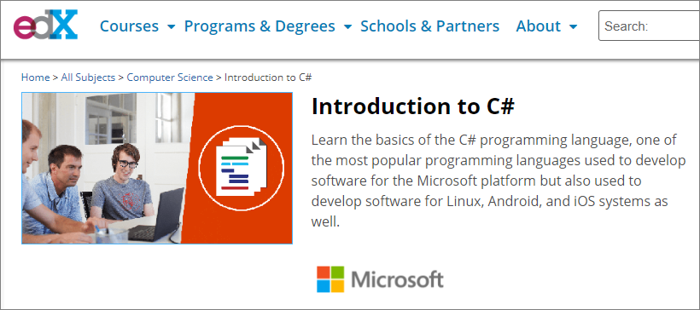
Introduction to C# (edX)(DEV204.1x)
https://www.edx.org/course/introduction-to-c

Slide 2
Module 0 – Course Welcome and Introduction
Grading
If you are taking this course for a verified certificate, you will be graded on self-check questions and homework assignments. The homework assignments will be graded using assessment questions.
The self-check questions make 50% of the total grade.
The homework assignments make up 50% of the total grade.
A combined grade of 70% is required to pass the course.

Slide 3
Course Outline
Module 2: Decision Statements | Module 3: Methods | Module 4: Course Conclusion
Lesson Introduction The if Statement Self-Check The switch Statement Self-Check Repetition in C# Introducing Repetition The for Loop The while Loop The do Loop Demo: Control Statements Self-Check Self-Check Module Lab Tutorial Lab 1 Using if Statements Tutorial Lab 2 Using a switch Statement Tutorial Lab 3 Using a for Loop Tutorial Lab 4 Using while and do Loops Self-Assessment Lab | Method Declarations Calling Methods Returning Data from Methods Method Overloading Optional and Named Parameters Demo: Methods Self-Check Self-Check Exception Handling Introducing Exception Handling Exception Propagation Handling Exceptions The finally Block Throwing Exceptions Demo: Exception Handling Self-Check Self-Check Module Lab Tutorial Lab 1 Creating and Using Methods Tutorial Lab 2 Exception Handling Self-Assessment Lab | Post-Course Survey

Slide 4
Module 1
Introducing C#
Introduction
The Tools
Visual Studio
C# Basics
Data Types
Module Lab
A History of C#
.NET Framework Overview
Xamarin
MonoDevelop
TextPad
Notepad
A Tour of Visual Studio
Tutorial Lab
Self-Assessment Lab
Lab Assessment Questions
Statements
Identifiers
Operators
Data Type Conversions
Demo: Data Types
Self-Check Questions

Slide 5
Module 1.1.2 - A History of C#
The C# programming language was born in 1999 at Microsoft. The original name was COOL for C-like Object-Oriented Language but it was later changed to C# (pronounced C sharp).
It was created by Anders Hejlsberg to help address the shortcomings of other programming languages in use at the time. The language is strongly-typed, object-oriented, and component oriented and utilizes a unified type system. Unlike C or C++, C# handles memory and resource management for the developer, lending to the concept of managed code.
C# uses a garbage collection mechanism to release memory and resources that are no longer referenced in the application code, helping to prevent memory leak issues.
Some C# features are:
Strongly-typed - the languages enforces type checking on objects in the code meaning it is type-safe
Object-oriented - C# offers the developer all the tenets of OOP such as encapsulation, inheritance, and polymorphism
Component-oriented - C# permits the creation of software components for self-contained, self-describing packages of functionality
Unified type system - all C# types, from primitive to reference types, inherit from a single root known as Object

Slide 6
Module 1.2.2 - Xamarin
You can develop native Windows, iOS, and Android apps by using the Xamarin platform and C#. Xamarin uses various technologies such as Xamarin Studio as well as designers for Visual Studio. The Xamarin platform will run on iOS and Windows computers so you can code on your choice of operating system.
The Xamarin development environment is now known as Visual Studio for the Mac when installed on a Mac OS computer.
You can download Xamarin at this URL https://aka.ms/edx-dev204_1x-xmr.

Slide 7
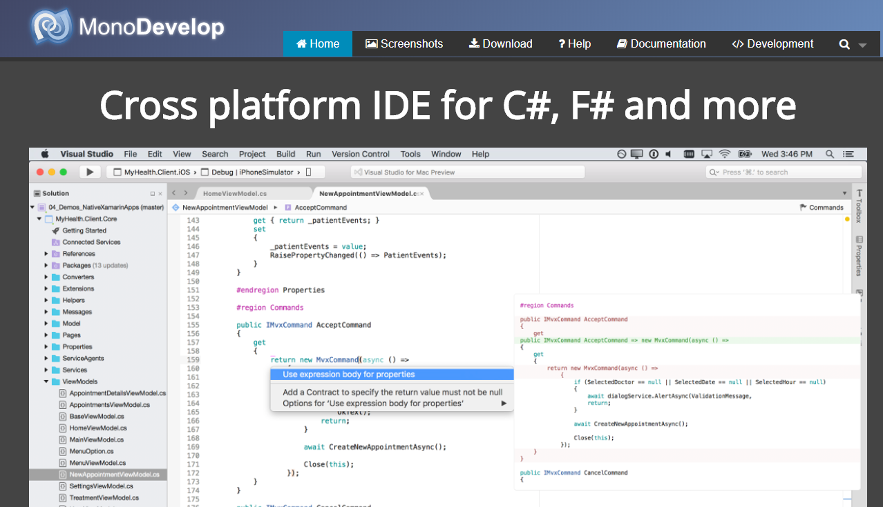
Module 1.2.3 - MonoDevelop
MonoDevelop is another toolset that you can use to create applications with C#. It is positioned as a cross platform IDE that allows you to write desktop or web applications that can run on Linux, Windows, and Mac OS X.
MonoDevelop offers the following features:
Multi-platform support
Code completion
Integrated debugger
GTK# Visual Designer
Source Control
Unit Testing
Packaging and Deployment
Find it at http://www.monodevelop.com

Slide 8
Module 1.2.4 - TextPad
TextPad has been around for many years and is sometimes known as The Text Editor for Windows. TextPad is essentially a plain text editor that runs on Windows. It supports different programming and scripting languages through add-ons known as clip libraries, dictionaries, macros, and syntax definitions. When using TextPad to write C# code, you'll be most interested in the Syntax Definitions that provide the keyword color highlighting.
Choosing a tool like TextPad means that you have a lightweight editor for your C# code files but it also means that you don't get the full benefits of an IDE and as such you will be responsible for:
Managing multiple files for your project
Compiling the code using the command-line compiler tools from Microsoft
Manual debugging of the code through code review
Manual deployment of the application
You can download TextPad at this URL, http://www.textpad.com/download/.

Slide 9
Module 1.2.5 - Notepad
Of course Microsoft Windows has the venerable Notepad app included with every copy. You can write your code in Notepad and then use the command-line compiler csc.exe to compile your code.
Take note that you will not realize any benefits such as code completion, Intellisense, syntax highlighting, or complete project solution and file management. And you will need to learn the available options and switches for the command line compiler.

